Slide 1



Crypto currency dashboard by kamal kumar
View in Power BI
Last data refresh:
11/4/2021 4:51:16 PM UTC
Downloaded at:
1/17/2022 12:12:12 PM UTC

Slide 2

Introduction
Notes:
textbox
No alt text provided
textbox
No alt text provided

Slide 3
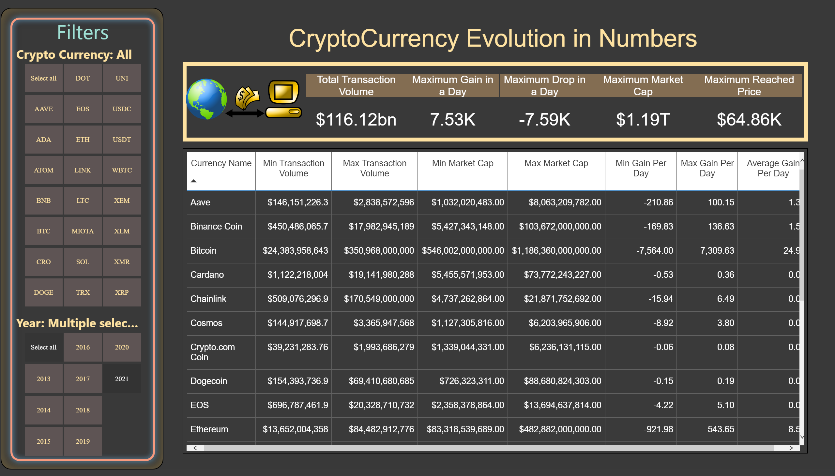
Tabular Report
Notes:
Maximum Drop in a Day
No alt text provided
image
No alt text provided
tableEx
No alt text provided
shape
No alt text provided
slicer
No alt text provided
Year
No alt text provided
Filters
No alt text provided
Maximum Reached Price
No alt text provided
Maximum Gain in a Day
No alt text provided
Total Transaction Volume
No alt text provided
Maximum Market Cap
No alt text provided
textbox
No alt text provided

Slide 4
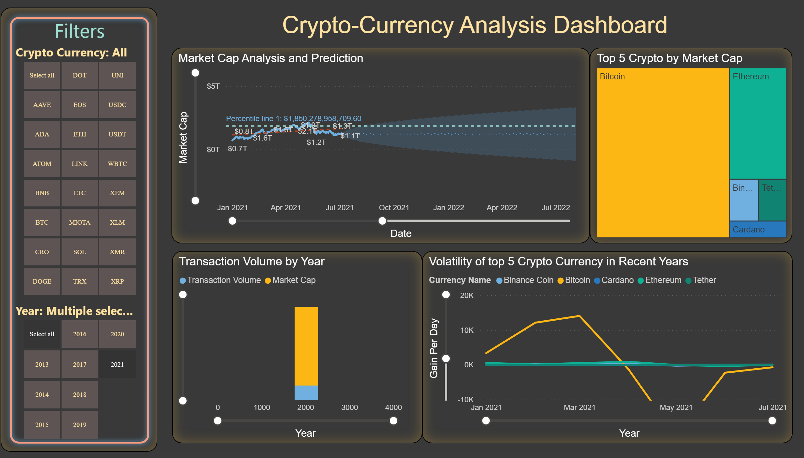
Analysis and Prediction
Notes:
Volatility of top 5 Crypto Currency in Recent Years
No alt text provided
slicer
No alt text provided
Year
No alt text provided
Filters
No alt text provided
Market Cap Analysis and Prediction
No alt text provided
Top 5 Crypto by Market Cap
No alt text provided
Transaction Volume by Year
No alt text provided
textbox
No alt text provided

